Slide 1

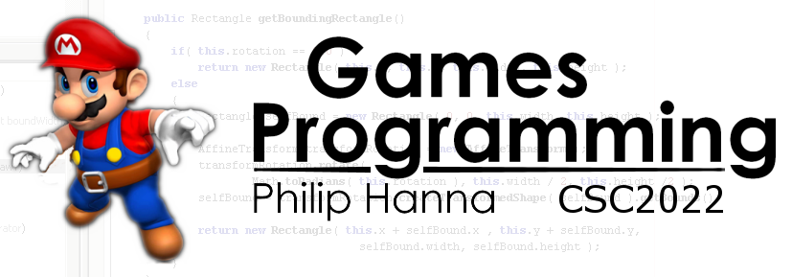
UX Design
Designing with the user’s experience in mind.
Part 2 - Structuring

Slide 2

Seeking Structure

Slide 3
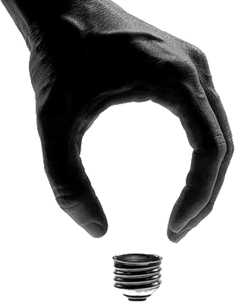
The Gestalt Principles were developed by German psychologists in the 1920s to describe how people tend to perceive certain visual elements as either grouped or unified.

Slide 4
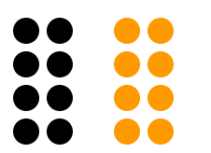
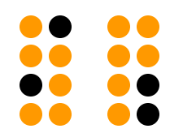
: Proximity
The relative distance between objects shapes how your brains group objects. Objects that are near each other (relative to other objects) appear grouped, while those that are farther apart do not.
All of these principles have direct relevance to how we present controls and UI elements to the user.

Slide 5
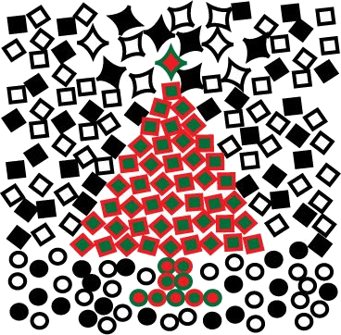
: Similarity
Objects that are similar in appearance appeared grouped, all other things being equal.
The hollow stars and the red and green shapes appeared grouped.

Slide 6
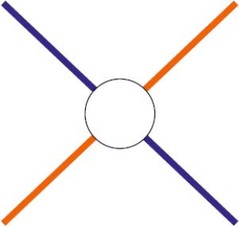

: Continuity
We perceive continuous forms rather than disconnected segments.
We two crossed lines, as opposed to four line segments, or the letters IBM as opposed to a collection of lines.

Slide 7
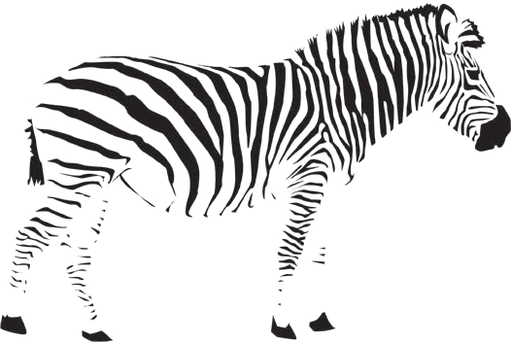

: Closure
We try to close open figures so that they are perceive as whole objects.
We do this even if no part of the perceived object has been drawn).

Slide 8
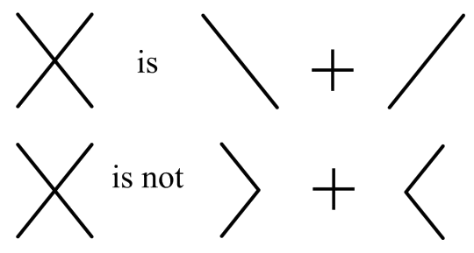
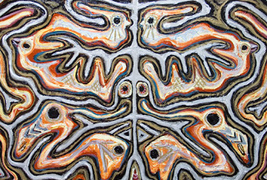
: Symmetry
We tend to view scenes in a way that reduces the perceived complexity
[ ] { } [ ]
[ ]
{ }
[ ]
is + +
[
] {
} [
]
is not + + +

Slide 9

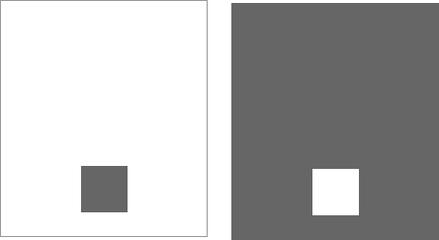
: Figure/Ground
We separate a visual field into one or more foreground elements (which attract our attention). What remains is the background.
We perceive a small black square on a white background and a large back square with a ‘hole’.

Slide 10

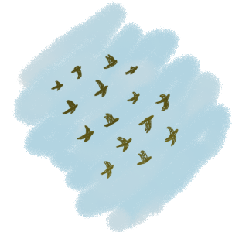
: Common Fate
Objects that are moving together are perceived as grouped or related.

Slide 11
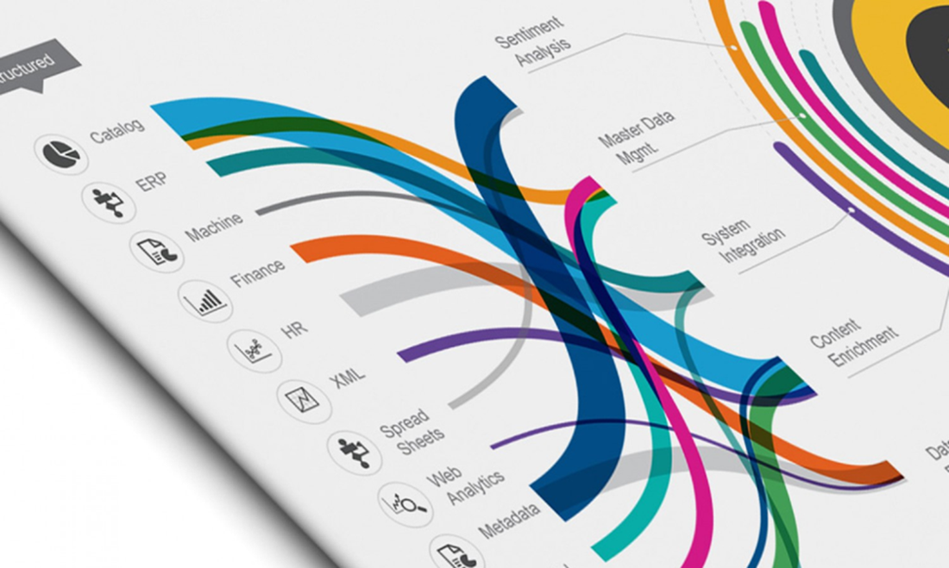
We Seek and Use Visual Structure

Slide 12
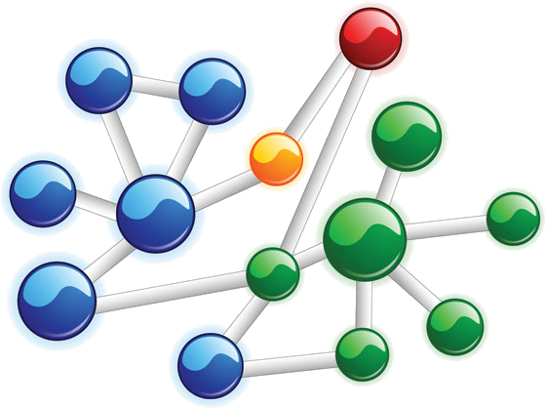
A visual hierarchy:
Separates information into different sections and subsections.
Clearly labels each section and subsection to identify its content.
Presents the sections and subsections as a hierarchy.
Well structured information can be easily and quickly scanned. Simple information can often be more easily understood.

Slide 13
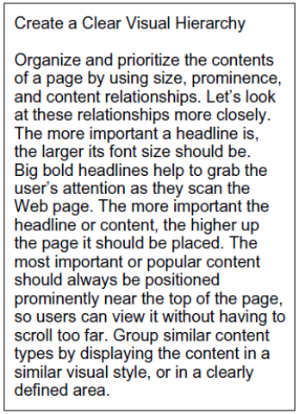
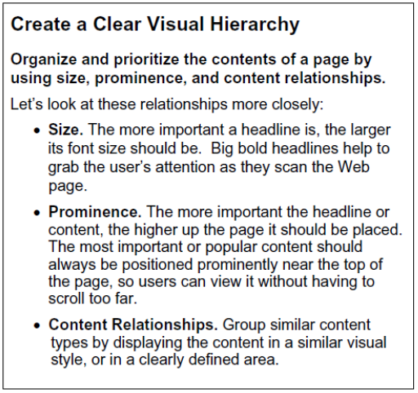

Slide 14
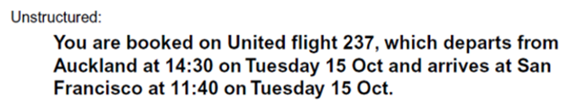
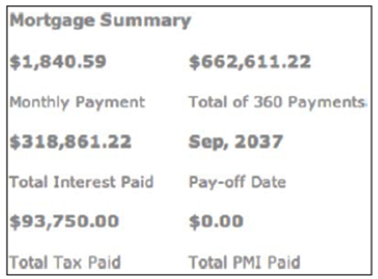
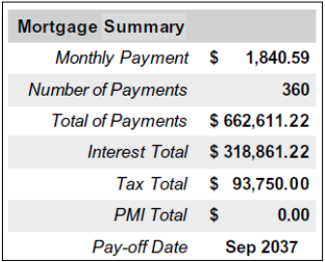
Consider the following examples. Which are more easily scanned?

Slide 15
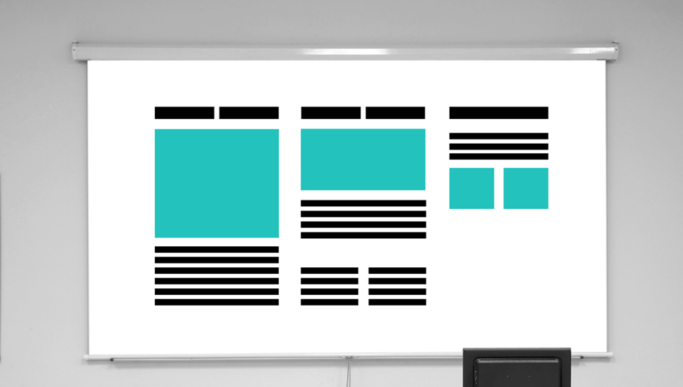
Support scanning; don’t disrupt it.
Support Scanning; Don’t Disrupt it
Help the user to easily separate what is relevant to their goals from what is not.
Structure information in a hierarchy. Emphasis key information. Use lists, tables, etc. to manage complexity.
Provide a clear visual flow through the hierarchy.

Slide 16

Key takeaways:
We’re ‘hardwired’ to see certain forms of visual structure.
We can quickly scan information that is presented in a clear visual hierarchy.
Our designs should enable users to quickly and easily scan and digest provided information.

